Slide 1

Male reproductive system
Physioloize it to visualize it….
Presented by: Dr. Mazin S. A. M
MBBS, Bogomolets National University….
Diploma in Research methodology and biostatistics, University of science and Technology….
Cardiology MD, Saransk city, Russian Federation….
Masters degree in human physiology, Ribat National University….
Masters degree in Molecular medicine, Khartoum University….

Slide 2
The male reproductive system:
produces and delivers sperm cells (spermatozoa) to the female reproductive tract .
The female reproductive system:
produces and allows egg cells (oocytes ) to be fertilized by sperm.
supports the development of an offspring (gestation).
gives birth to a new individual (parturition) .

Slide 3
Formation of sperms:
Occurs in the seminiferous tubules during active sexual life due to stimulation by AP-GnRHs.
Begins at age of 13-16 years, continues throughout life & decreases in old age.
Sertoli cells:
Large cells that surround the developing spermatogonia around the central lumen of the seminiferous tubules.
Secrete androgen binding protein.

Slide 4
Leydig cell:
Lie between seminiferous tubules.
non-existent in the testis during childhood when the testis secrete no testosterone.
Numerous in the newborn male infants for the first few months of life.
Active at puberty & throughout adult life & secrete testosterone.

Slide 5
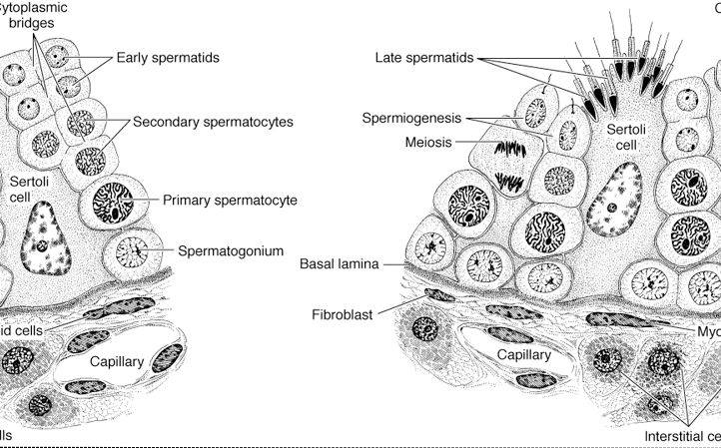
Cells of the testes
Sperms
1-Spermatogonium
2- Sertoli cells
3- Leydig cells

Slide 6
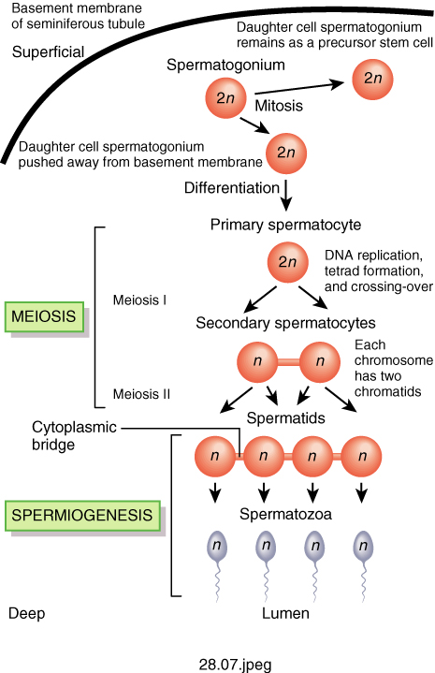

Slide 7
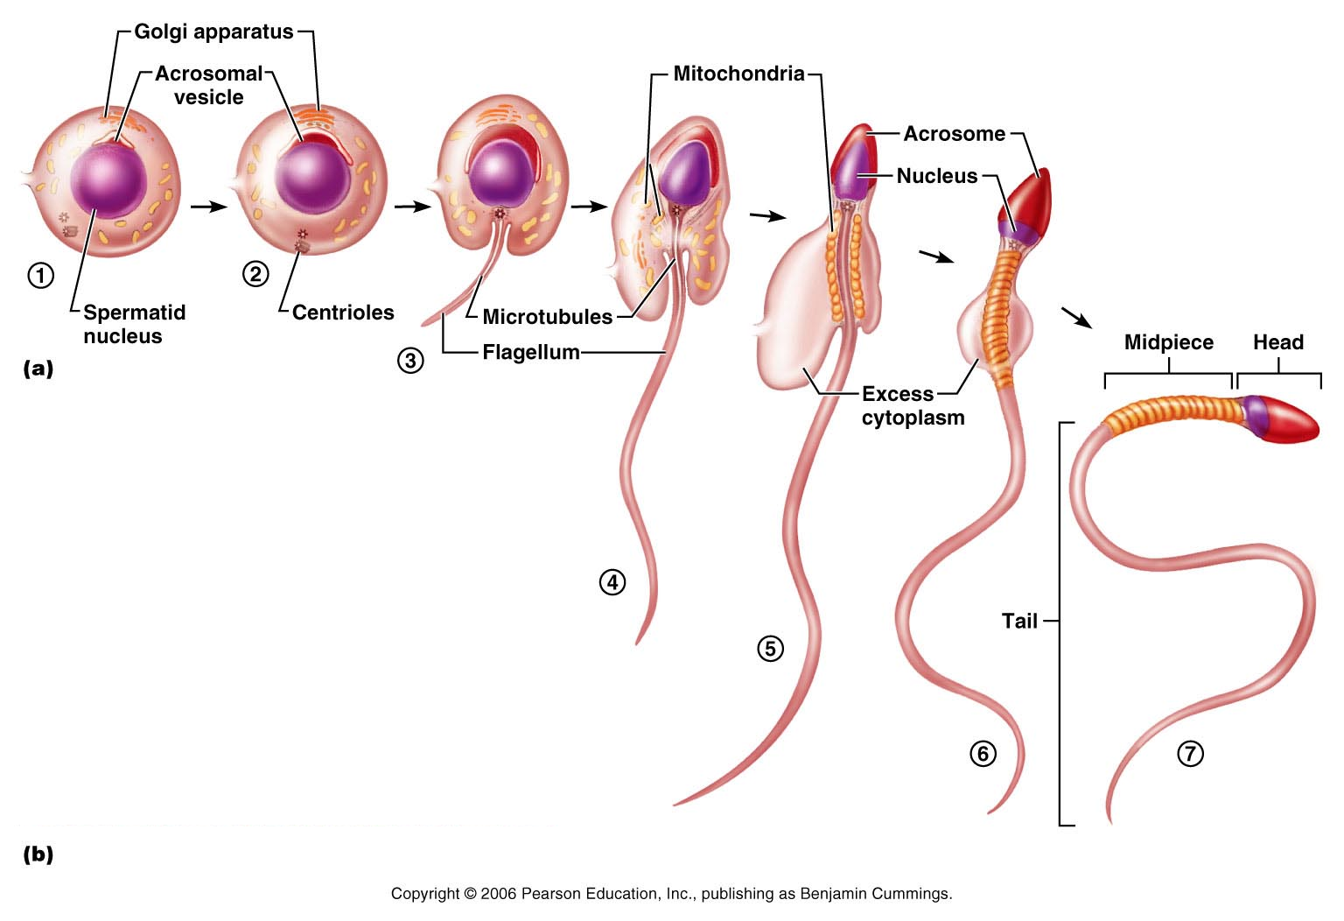

Slide 8
Spermatogenesis
Spermatogonia (containing 46 chromosomes) undergo DNA replication → primary spermatocytes (46 chromosomes).
Primary spermatocytes →secondary spermatocytes (46 chromosomes) → spermatids (23 chromosomes)
Spermatids → spermatozoa (23 chromosomes).

Slide 9
Formation of sperms
Sperm formed of head & tail:
Head contains: nucleus, cytoplasm & cell membrane
outside the the head is a thick cap called acrosome formed mainly from Golgi apparatus.
contains powerful proteolytic enzymes.
The tail : contain a collection of mitochondria which synthesized ATP which is important for sperm motility.

Slide 10
Maturation of sperm in the epididymis
After formation in the seminiferous tubules, the sperm require several days to pass through the epididymis (still non-motile).
After the sperm have been in the epididymis for some 18 to 24 hour, they develop the capability of motility.
some inhibitory proteins in the epididymal fluid prevent final motility until after ejaculation.

Slide 11
Storage of sperm
The 2 testis of adult human form up to 120 million sperm each day:
Small amount stored in the epididymis.
Majority stored in the vas deferens, maintaining their fertility for at least a month.
Sperms are kept in inactive state by multiple inhibitory substances in the secretion of the ducts.

Slide 12
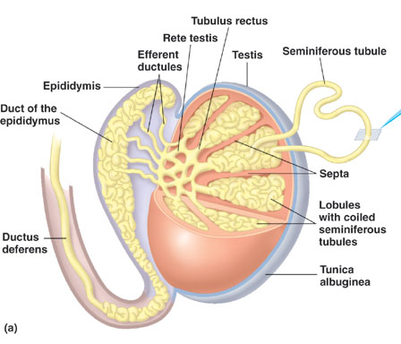

Slide 13
Physiology of mature sperm
Mature sperm are motile & capable of fertilizing the ovum.
their activity is enhanced in a neutral & slightly alkaline medium & depressed in mildly acidic medium.
The life of ejaculated sperm in the female genital tract is only 1 to 2 days.

Slide 14
Function of the seminal vesicles:
Secrete mucoid material containing fructose, citric acid & nutrient substances & large quantities of prostaglandins & fibrinogen.
Functions of prostaglandins :
Reacting with the female cervical mucus making it more receptive to sperm movement.
Causing peristaltic contractions of the uterus & fallopian tubes to move the ejaculated sperm toward the ovaries.

Slide 15
Function of the prostate gland
The prostate gland secretes thin milky fluid contains Ca²⁺, acidic phosphate, prostate specific antigen (PSA) & profibrinolysin.
Functions of alkaline prostate fluid:
1. Successful fertilization of the ovum.
2. Help to neutralize the slightly acidic fluid of the vas deferens.
3. PSA enhances motility of sperm by hydrolysis of substance that inhibit sperm motility.

Slide 16
Semen
Ejaculated semen is composed of:-
the fluid & sperm from the vas deferens (~10%).
fluid from the prostate gland (~30%).
fluid from the seminal vesicles (~60%).
small amounts from the mucous glands the bulbourethral glands.
pH is about 7.5.
Fluid from the seminal vesicles & mucous glands give the semen mucoid consistency.

Slide 17
Hormonal factors that stimulate spermatogenesis
1. Testosterone: secreted by the leydig cells is essential for the growth & division of testicular germinal cells (spermatids → sperm).
2. LH: secreted by AP. gland, stimulates the leydig cells to secrete testosterone.
3. FSH: secreted by AP. gland, stimulates sertoli cells to stimulate the conversion of spermatids to sperm.
4. Estrogen: formed from testosterone by the sertoli cell (aromatase enzyme) under FSH stimulation.
Essential for spermatogenesis.

Slide 18
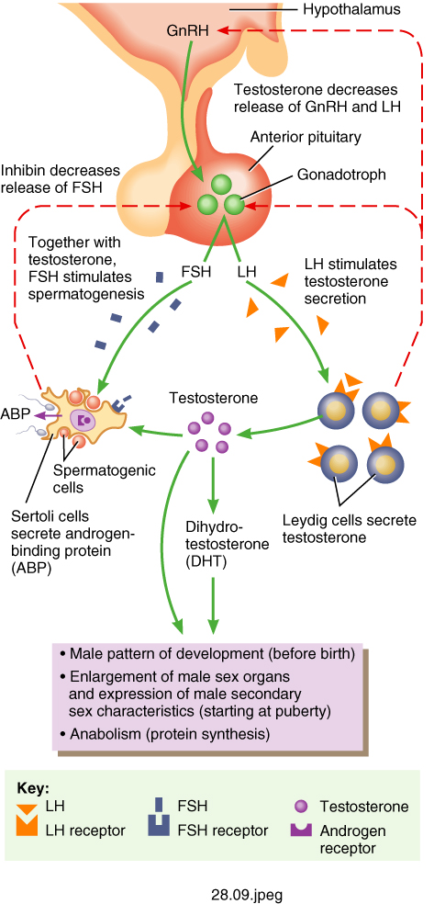

Slide 19
Regulation Testosterone production by LH:
Testosterone is secreted by leydig cells, Under LH stimulation .
when Testosterone ↑ inhibit LH secretion.
Mature leydig cells are found in a child’s testis few weeks after birth & then disappear until puberty when it appear again.

Slide 20
Regulation of spermatogenesis by FSH & testosterone:
FSH binds its receptors on the sertoli cell in the seminiferoustubules, which causes these cells to grow & secrete spermatogenic substances.
testosterone & dihydrotestosterone diffuses into the seminiferous tubules from the leydig cells affect the spermatogenesis.
Both FSH & testosterone are necessary to initiate spermatogenesis.

Slide 21
Testosterone
Secreted by Leydig cells in the testis.
dihydrotestosterone is the active form.
Testosterone converted into dihydrotestosterone in the target cells.
Metabolism of testosterone:
Testosterone bound with beta globulin & circulate in the blood for 30 minutes to several hours. converted to estrogen in the liver & excreted.

Slide 22
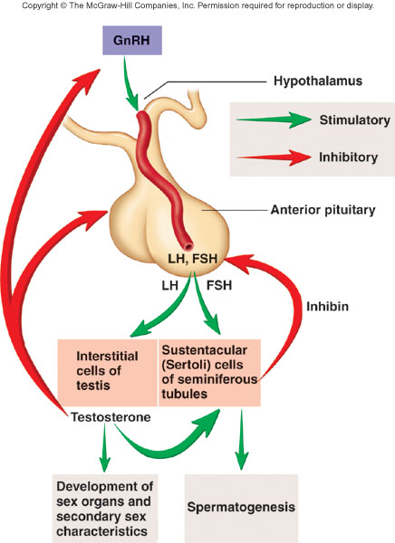

Slide 23
Mechanism of action
Testosterone is converted by intracellular enzyme 5ᵅ reductase to dihydrotestosterone , then it binds with cytoplasmic receptor .
This combination moves to nucleus where it binds a nuclear protein & induces protein formation.
It increases the rate of protein synthesis in target cells.

Slide 24
Functions of testosterone
It is responsible for the characteristic masculine body.
During fetal life: the testis are stimulated by placenta chorionic gonodotropin to produce testosterone.
throughout fetal life & the 10 weeks after birth then no more testosterone production during childhood.
at puberty under the anterior pituitary gonadotropic hormones stimulation throughout life & then decline beyond 80 years to 50%.

Slide 25
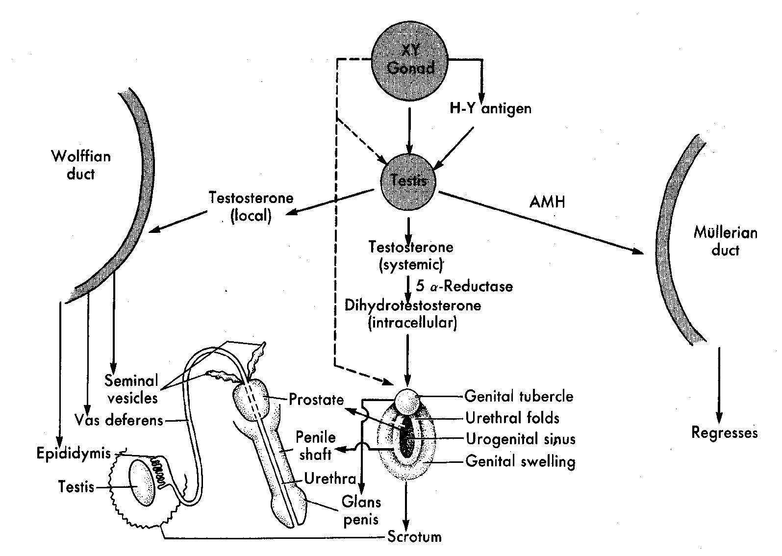

Slide 26
Function of testosterone during fetal development:
Testosterone secreted by the fetal testis is responsible for development of the male body characteristics (formation of male genitalia)
suppressing the formation of female genital organs.
Effect of testosterone to cause descent of the testis:
The testis descend into the scrotum during the last 2 to 3 months of gestation when the testis begin secreting testosterone.

Slide 27
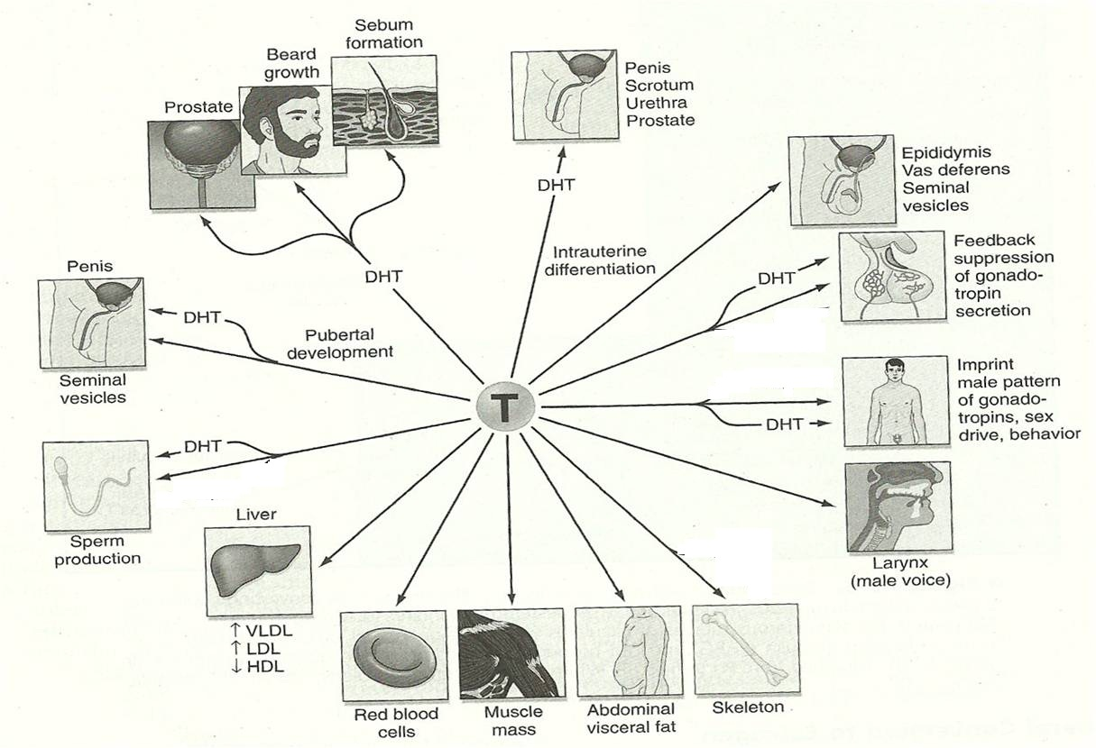
Actions of testosterone

